Slide 1
IV.Membuat Ide Bisnis Teknologi
Kewirausahaan Teknologi Informasi

Slide 2
Nasty Gal Case (baca hlm.48)
Bisnis apakah ini?
Apakah Value yang ditawarkan oleh Sophia Amoruso pada bisnisnya?
Menurut anda, mengapa bisnisnya dianggap bisnis berbasis teknologi?

Slide 3
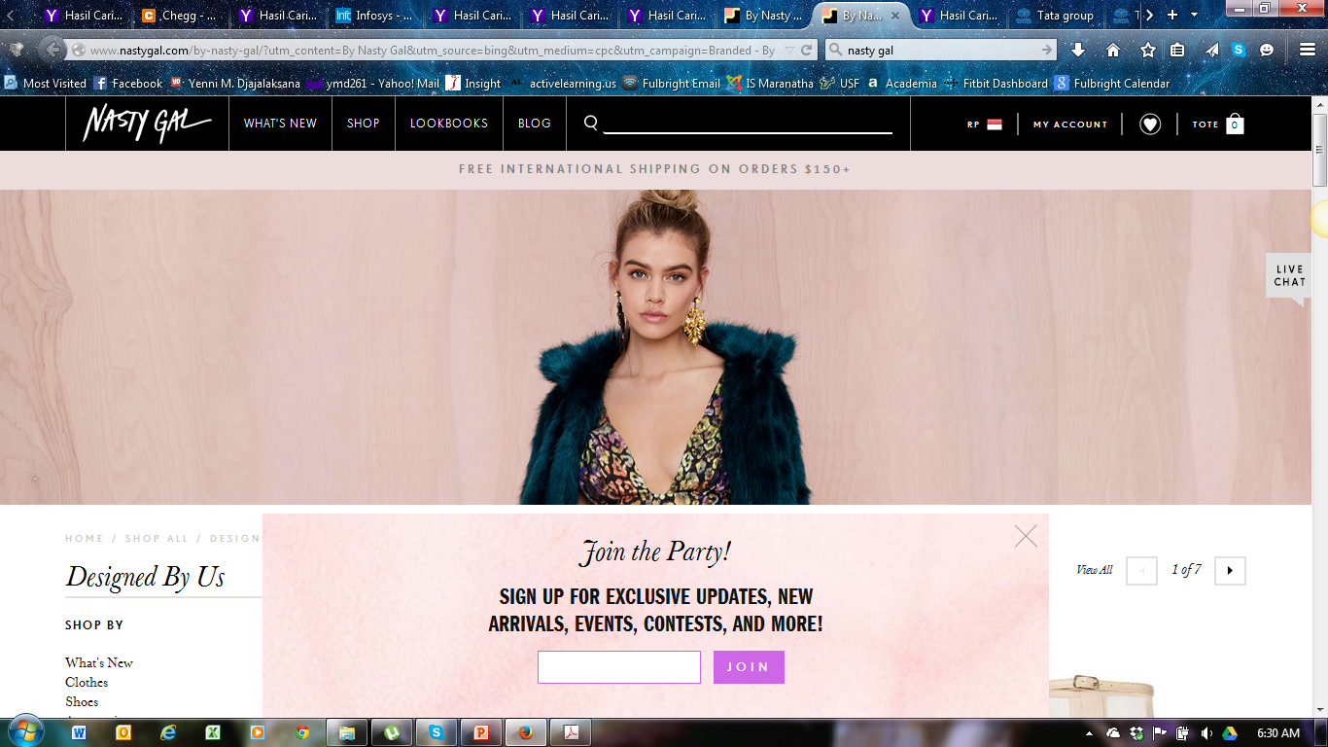

Slide 4

What business should I start?
Apakah baik bertanya pada teman dan keluarga?
Pertimbangkan tipe bisnis yang ingin anda mulai.

Slide 5
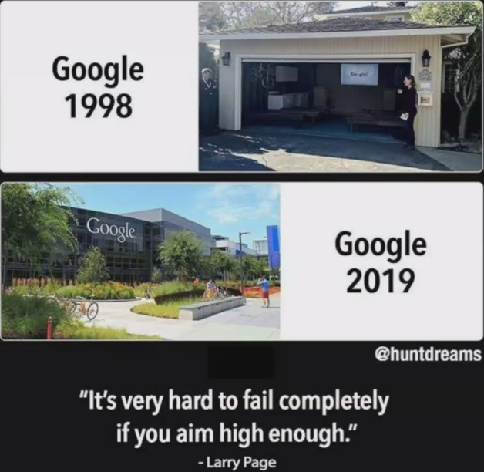
Google story begins in 1995 at Stanford University. Larry Page and Sergey Brin, a student there, has a mission “to organize the world’s information and make it universally accessible and useful.”

Slide 6
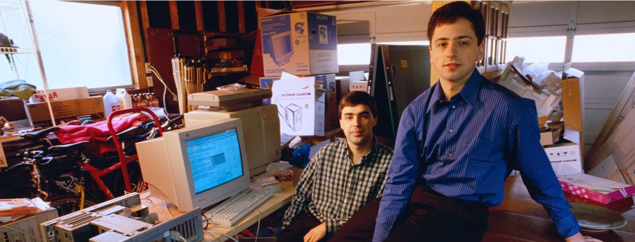
From the garage to the Googleplex
Over the next few years, Google caught the attention of not only the academic community, but Silicon Valley investors as well. In August 1998, Sun co-founder Andy Bechtolsheim wrote Larry and Sergey a check for $100,000, and Google Inc. was officially born.

Slide 7
Tipe Bisnis yang Mendasar (hlm.42)
B2C
Aspirin, personal computers DVD players, cars, motorcycles
Daycare, landscaping, television repair, roofing, dentist
B2B
Enterprise software, heavy machinery, mainfram systems
Building maintenance, shipping, training, accounting, travel planning
B2G
Military equipment, mainframe servers, secure automobiles, software
Security, surveillance, plant maintenance
Product
Service

Slide 8
Business to Business (B2B)
B2B memiliki modalyang lebih banyak dari B2C
Membeli dalam jumlah besar
Poin penting dalam menciptakan value:
Bantu perusahaan meningkatkan pendapatan
Bantu perusahaan menghemat uang
Bantu perusahaan agar dapat selaras dengan peraturan pemerintah/ norma masyarakat

Slide 9
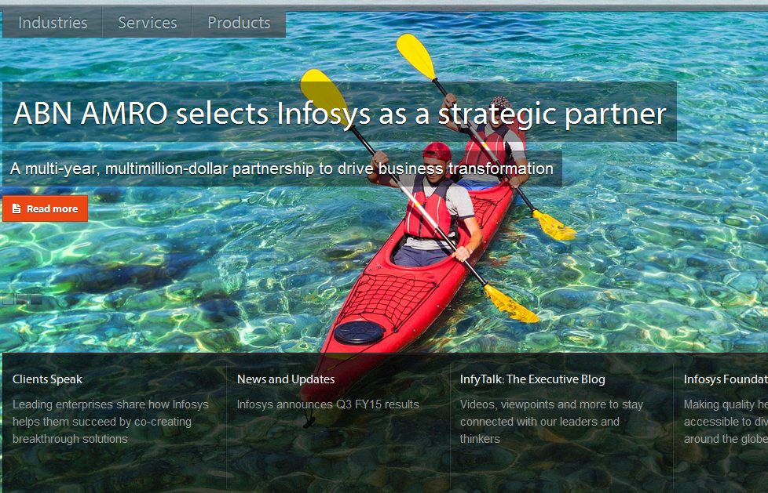
CONTOH B to B

Slide 10
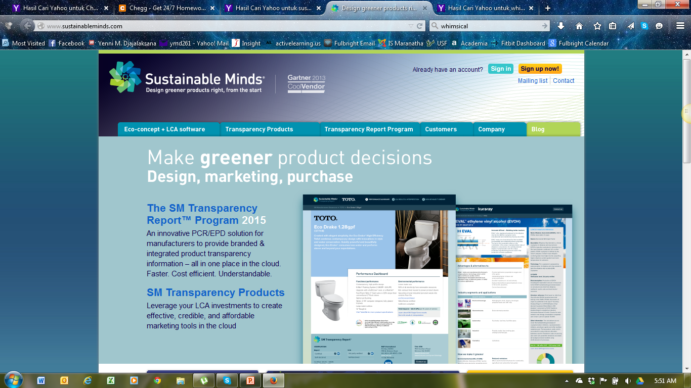

Slide 11
Sustainable mind : https://youtu.be/z_aCvUc-YjA
Greener product Concept

Slide 12
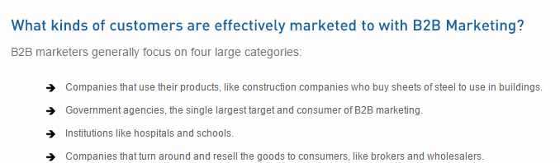

Slide 13

Business to Consumer (B2C)
Banyak kemungkinan
Poin penting dalam menciptakan value:
Meeting daily living needs
Fashionable
Adventurous
Whimsical (erratic, unpredictable)
Entertaining products/services

Slide 14
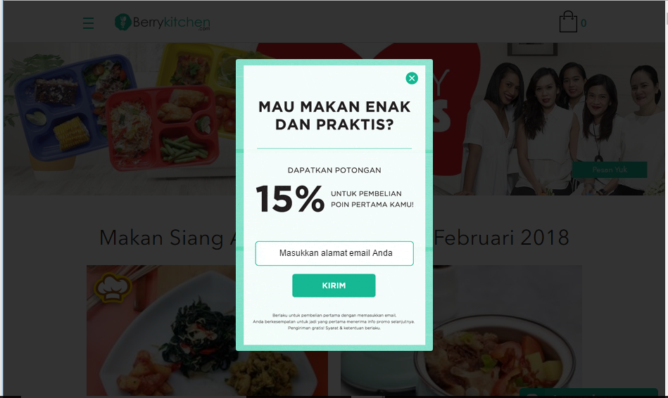
Website Berry Kitchen

Slide 15
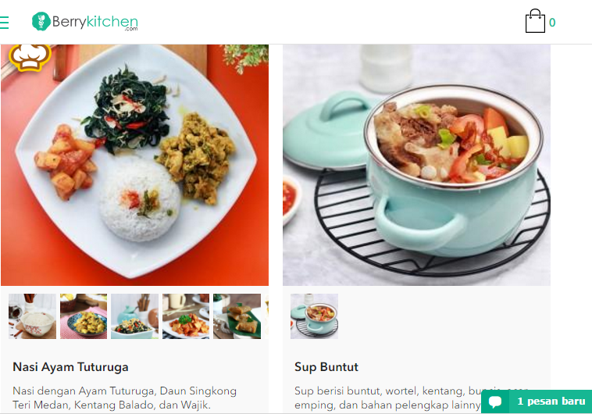

Slide 16
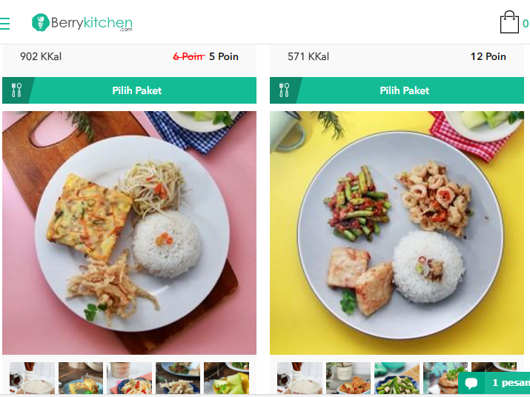

Slide 17
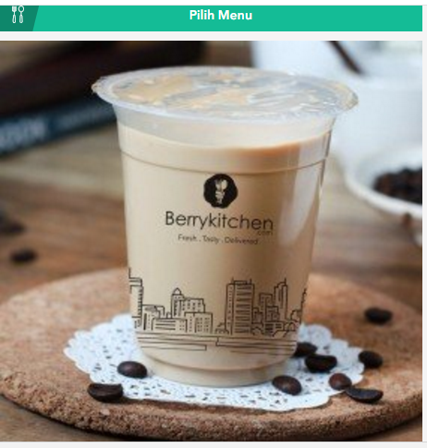
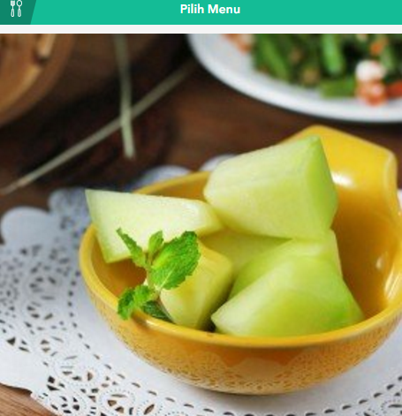
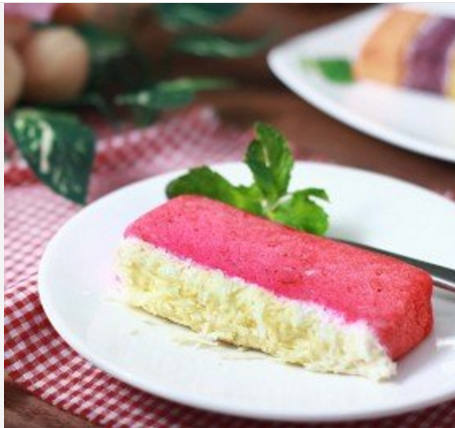
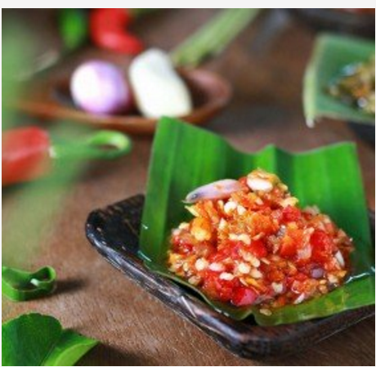

Slide 18

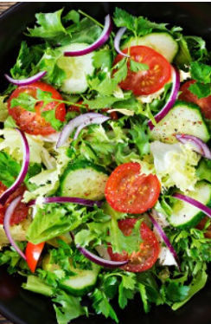
Makanan Sehat dan Minuman Herbal

Slide 19

Perlengkapan dekorasi
Barang Dekorasi

Slide 20

jastip
Jastip

Slide 21

Mengajar On line

Slide 22
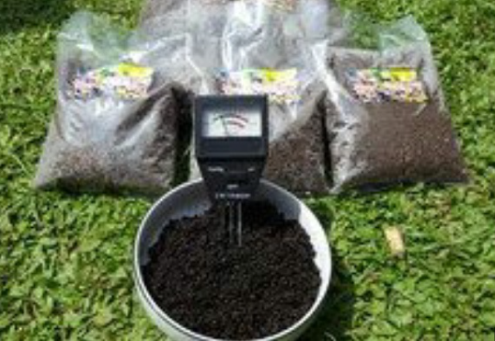
Pupuk Kompos /pupuk Hydro

Slide 23
Tips dalam B2C
Harus punya banyak ide
Jika sudah berkembang bisa disalurkan pada jalur distribusi retail yang besar (Carrefour, Toko Yogya, Indomaret, dll)
Konsistensi dari Brand Image
Brand→
Personal Brand :
* Hotman Paris :pengacara
Product Brand:
* Rinso, Aqua

Slide 24
Business to Government (B2G)
Mirip dengan B2B
Ada kompleksitas untuk membuat kontrak dengan pemerintah yang harus ditaati
Tentunya di setiap negara ada aturan yang berbeda

Slide 25
Proses Membuat Ide Bisnis
1. Identify a point of pain in a target market
2. Innovate a product or service
4. Explore how to acquire customers
3. Test business model

Slide 26
Point of pain
Customer pain points are as diverse and varied as your prospective customers themselves.
We have to help your prospects realize they have a problem and convince them that your product or service will help solve it.

Slide 27
Type dari customer point of pain
Financial Pain Points: Spending too much money on their current provider/solution/products and want to reduce their spend
Productivity Pain Points: Wasting too much time using their current provider/solution/products or want to use their time more efficiently
Process Pain Points: Your prospects want to improve internal processes, such as assigning leads to sales reps or nurturing lower-priority leads
Support Pain Points: Your prospects aren’t receiving the support they need at critical stages of the customer journey or sales process

Slide 28
What should we do ?
Financial: Emphasize lower price point (if applicable), highlight the average savings of your client base, use language that reiterates better ROI
Productivity: Highlight reductions in wasted time experienced by current customers, emphasize ease-of-use features (such as at-a-glance overviews or a centralized dashboard)
Processes: highlight how your product/service can make typically difficult/time-intensive tasks easier
Support: Help the prospect feel like a partner by highlighting your after-market support, use connecting language (“us,” “we” etc.) in your copy

Slide 29
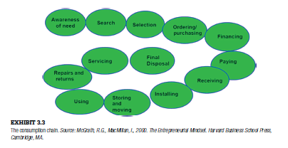
1. Identify a point of pain in a target market
Pikirkan siapa target pasar anda
Tentukan apakah masih ada “point of pain”

Slide 30
How to identity You Customer point of paint?
Survey Customers with the Right Questions. Most often you'd think, what can be so difficult about sending out a survey to your customers. ...
Get your Sales Team Talking. ...
Check Out Online Reviews. ...
Take a Look at Your Competitors.

Slide 31
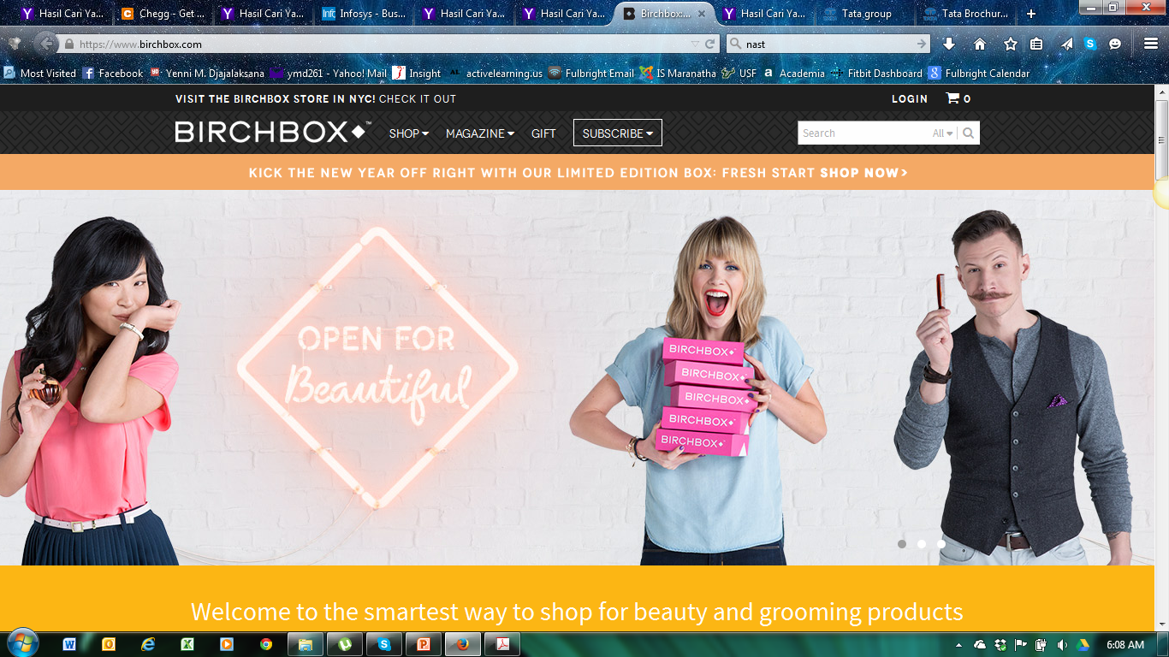
(hlm. 57)

Slide 32

Birchbox Case (hlm. 48)
Bisnis apakah ini?
Apa yang dilakukan untuk menarik konsumennya?

Slide 33

2. Innovate a Product or Service
Both an art and a science
Teknik melakukan inovasi produk/jasa:
“Look at what is bugging you”
“Be present in life”
“Let your subconscious do the work”
“Attack practical problems”
“Think big”

Slide 34

Coffee Joulies Case (hlm. 58)
Apa masalah yang dipecahkan oleh Coffee Joulies?
Inovatif? Kenapa?

Slide 35
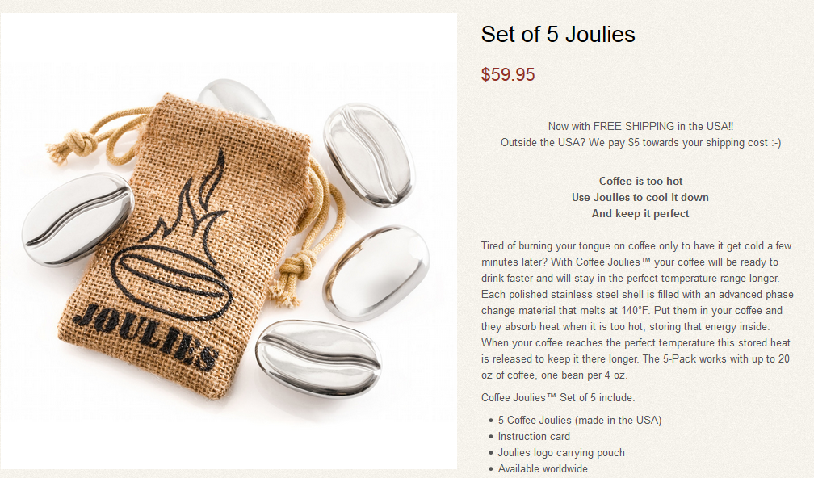

Slide 36
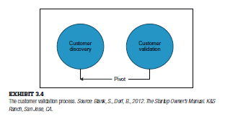
Customer Validation Process

Slide 37

3. Test Business Models
Memeriksa apakah bisa menghasilkan uang
Baik langsung dari produk/jasa atau dari komersial (ads)

Slide 38
Business Models (baca hlm. 52)
Use the business model canvas (materi 3)
Pay as you go
Freemium→ dropbox
Billable hours→ fee per hour
Advertising based→ no charge, adv fee
Subscription pricing
Distributor or reseller
Retailer/Wholesaler: Amazon, Fab and Gilt
Landlord-Leaser-Licensor
Broker→ tidak beli/jual tp fasilitasi buyer dan seller

Slide 39

4. Explore How to Acquire Customers
Bagaimana mendapatkan konsumen?
Pertimbangkan keseimbangan antara jumlah demand dan supply.
Berapa banyak yang anda dapat produksi untuk memenuhi permintaan konsumen?

Slide 40

Non-Traditional Idea Sources
Read alternative literature
Visit new places & experience new things
Meet thought leaders
Team up

Slide 41
Pustaka
N. Duening, R. A. Hisrich and M. A. Lechter, Technology Entrepreneurship, Burlington: Elsevier Science, Academic Press, 2015.→ e Book, bahan kasus.
Thiel, Peter, Zero to One, Notes on Startups, or How to Build the Furture , Crownpublishing Group ., penguin Random House Company, New York, 2014
Case study dan Artikel yang membahas tentang bisnis teknologi informasi
https://www.popmama.com/life/health/sarrah-ulfah-1/ide-bisnis-umkm-yang-cocok-dikembangkan-di-tahun/7

